Slide 1

AKS Office Hours
Kendall Roden
Cloud Native Technical Specialist
Kendal Roden
Cloud Native Technical Specialist
Dave Strebel
Cloud Native Technical Specialist

Slide 2
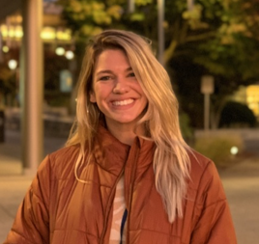
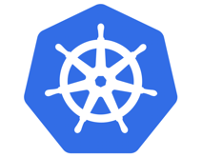
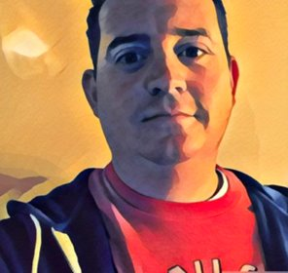

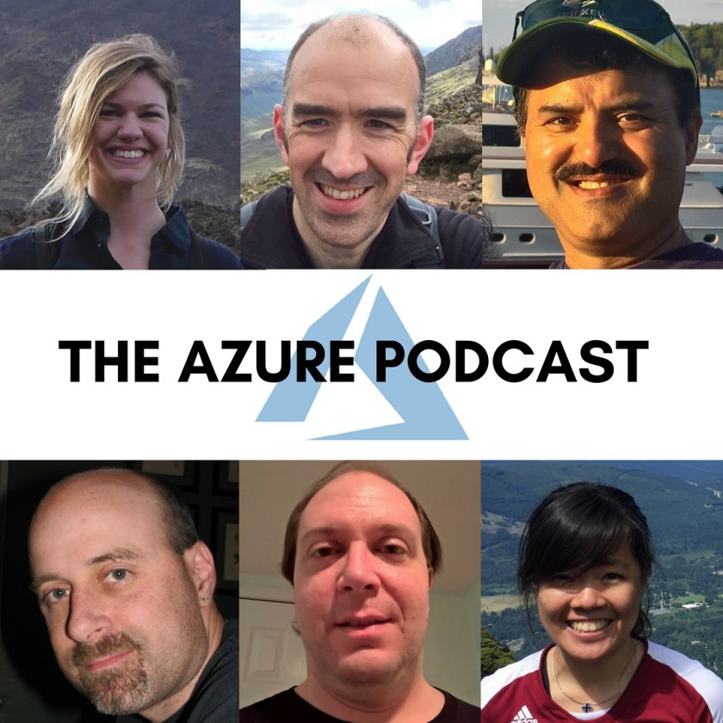

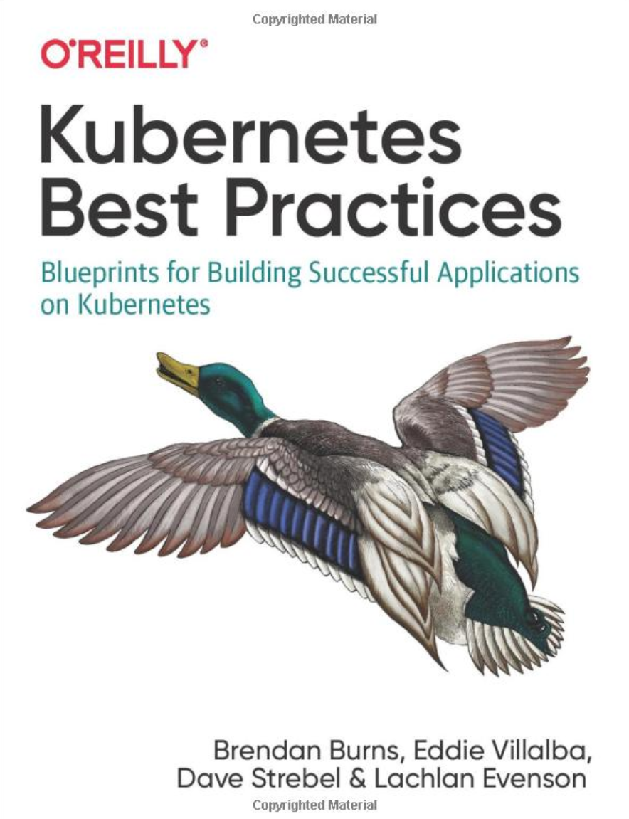
Who are we?
@kendallroden​
@dave_strebel​

Slide 3
Why AKS Office Hours?
Provide AKS customers with updates pertaining to AKS and the Cloud Native Ecosystem
Host a short talk and/or demo on Cloud Native technologies related to Kubernetes and AKS
Collect feedback from customers on issues, blockers, use cases, and questions related to AKS

Slide 4
What to expect
Call agenda
5-10 minutes: Welcome, followed by AKS and ecosystem updates
20-30 minutes: AAD-Enabled clusters
20-30 minutes: “Ask us anything” and customer feedback discussion
Keep in mind
We want two-way interaction, but please stay on mute when you are not speaking
This call and how it is conducted will evolve based on feedback and growth
Office hours are hosted primarily by the GBB team, with the support of the PG
Recordings and content will be available post-call, barring any technical difficulties
Contact us with thoughts, ideas or questions (aksofficehours@microsoft.com)

Slide 5

AKS Updates

Slide 6
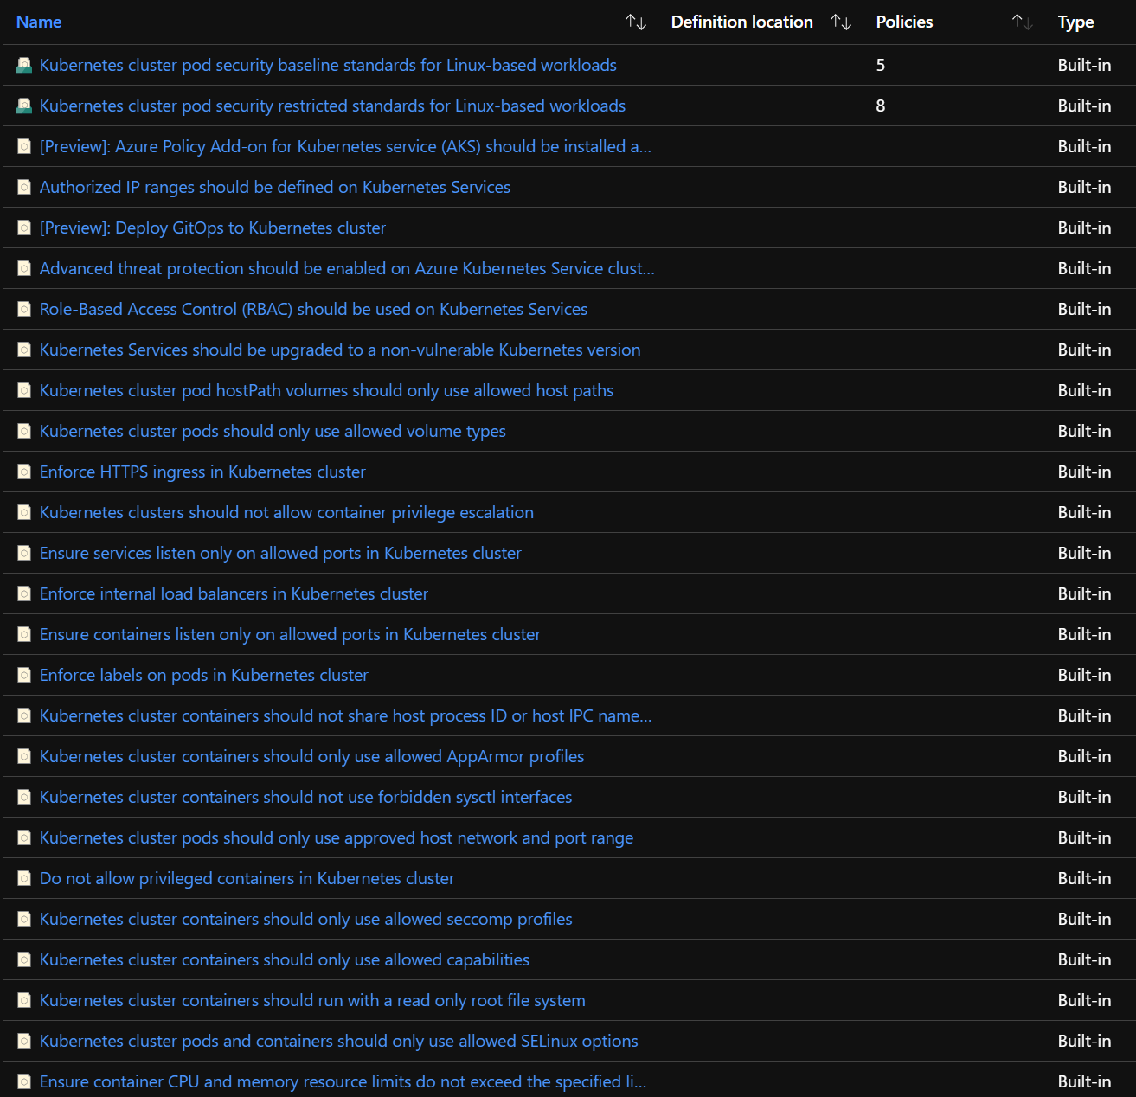
AKS Updates - GA
GA of Azure Policy For Kubernetes
AKS Roadmap: http://aka.ms/aks/roadmap

Slide 7
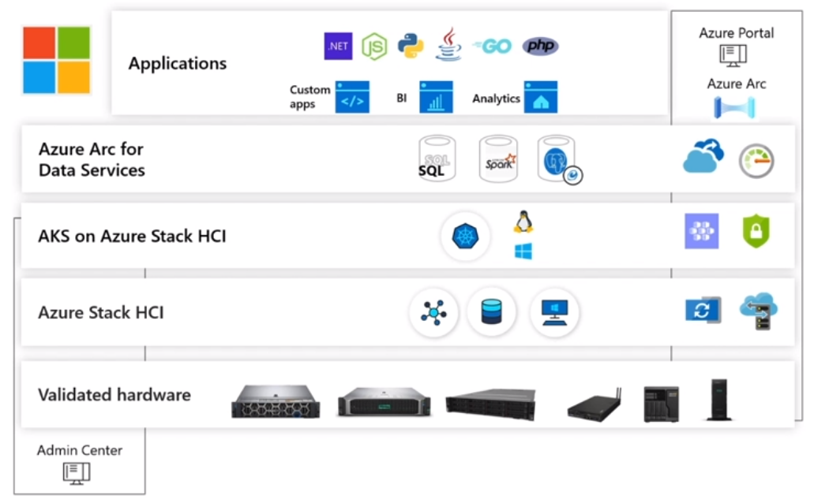
AKS Updates - Preview
Preview – Stop/Start Clusters
Azure Kubernetes Services (AKS) on Azure Stack HCI
AKS Roadmap: http://aka.ms/aks/roadmap

Slide 8
Ecosystem Updates

Slide 9
Ecosystem Updates
Open Service Mesh (OSM) accepted into CNCF as a sandbox project
KubeEdge approved as Incubating Project
On September 14, CVE-2020-14386 was reported as a “high” severity threat
- Security vulnerability that enables an unprivileged local process to gain root access

Slide 10
Content from demo
https://github.com/swgriffith/azure-guides/tree/master/aad-auth-demo

Slide 11
Thank you! Join us for our next call on October 8th!

